Slide 1
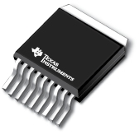
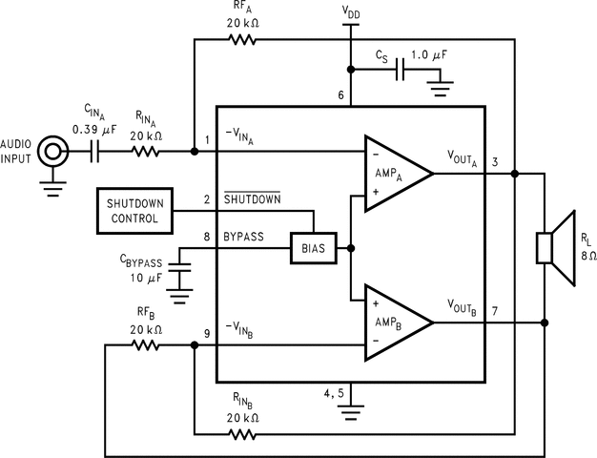
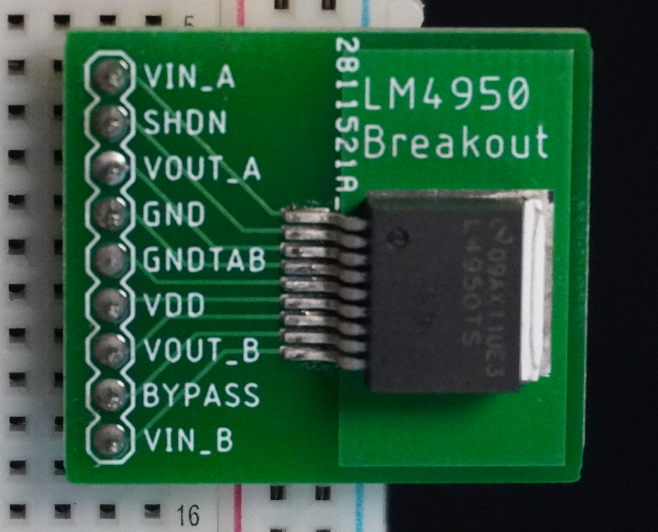
IEEE Projects
Amplifier Workshop
Notes:
what is an amplifier
what is this ic
quick circuit overview

Slide 2
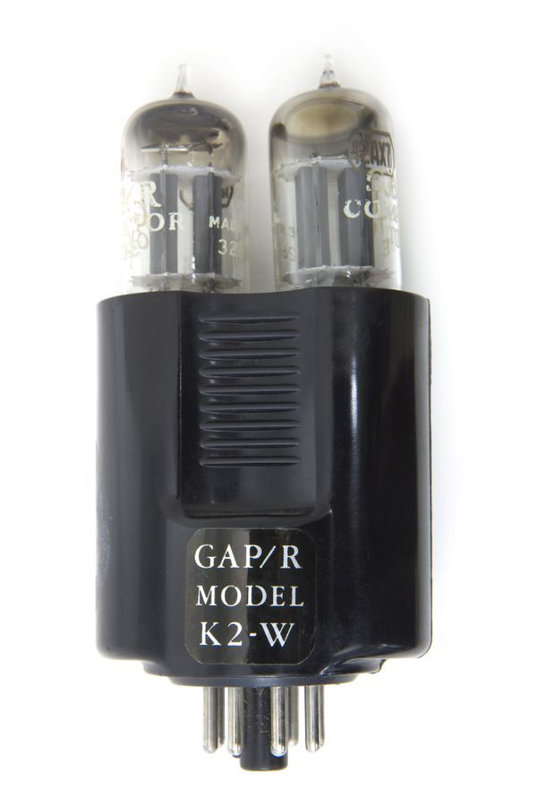
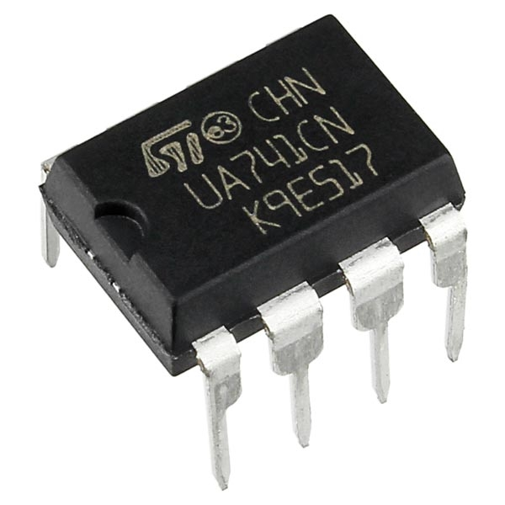
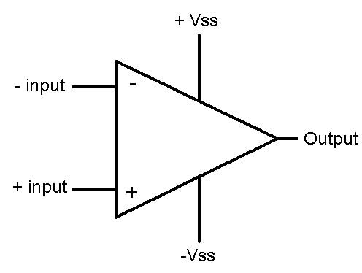
What is an amplifier
Op-amps
Invented by Bell Labs in 1940s
Only became compact, cheap after transistors
Amplifies the difference between two inputs
V_{OUT}=A_{OL}(V₊-V₋)
V_{OUT} limited by voltage supplied
Comparators
High-gain op-amp
Returns digital signal based on inputs
V₊ > V₋ ⇒ V_{OUT} = 1
V₊ < V₋ ⇒ V_{OUT} = 0
Top Left: K2-W Op-Amp from Bell Labs
Top Right: The UA741 started the trend of compact, cheap op-amps
Bottom: Simplified pinout of an op-amp
‹#›
Notes:
dont go too in detail here

Slide 3
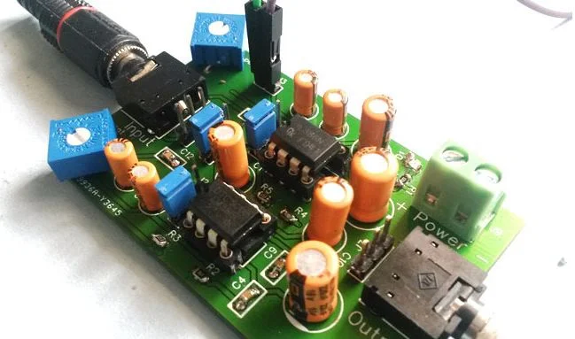
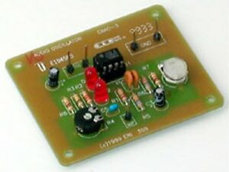
Applications
Audio Amplification
Oscillators
Signal Generators
Filters
Analog to Digital Converters (ADCs)
Digital to Analog Converters (DACs)
And More!
Top Right: a stereo audio amplifier using two LM386 op amps
Bottom Left: A Wien-Bridge Oscillator using an op-amp
‹#›

Slide 4
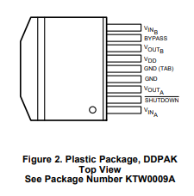
What IC are we using?
LM4950
The LM4950 is designed for sound amplification
‘power amplifier’
Composed of two op-amps
Two Vin and two Vout for left and right channels
Class AB audio amplifier
A: lower efficiency but highest sound fidelity
B: higher efficiency but worse sound quality

Slide 5
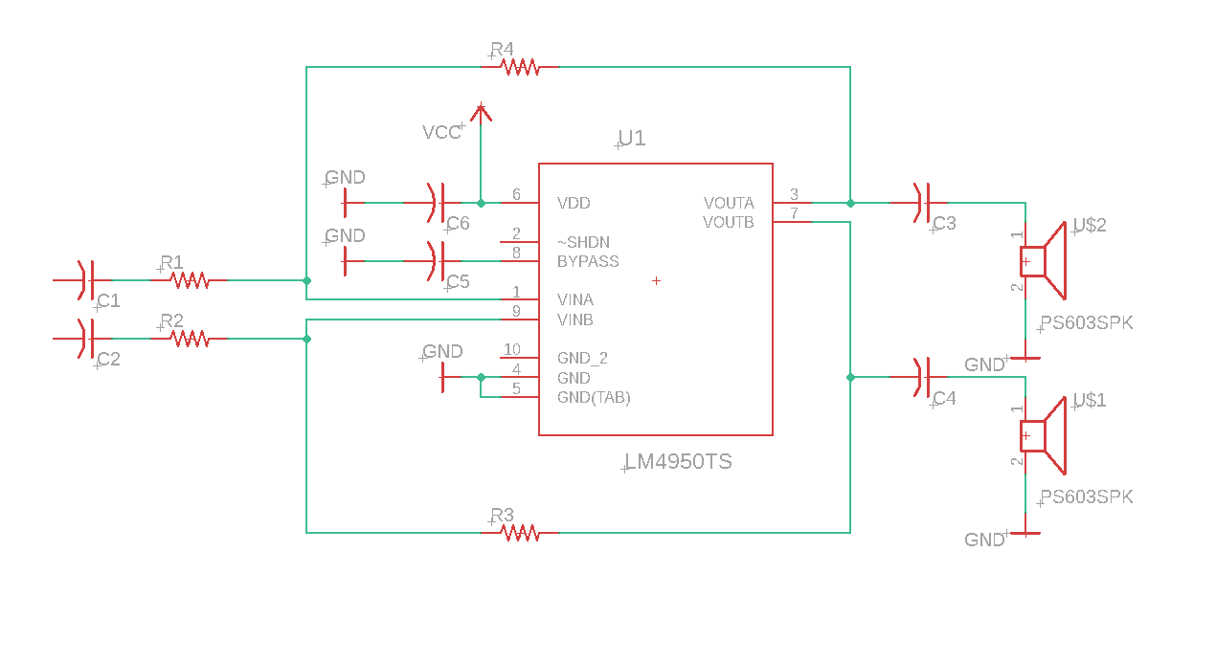
Circuit Overview
The LM4950 is permanently configured for an inverting amplifier design!
Why would it be configured this way?

